Slide 1
2.3: Introduction to Pattern-Based Design
Definition of Pattern-Based Design:
- A structured approach that utilizes established solutions, known as patterns, to address recurring design problems.
- Incorporates best practices derived from experience, user needs, and system requirements.
Importance of Pattern-Based Design:
- Increases design efficiency by allowing designers to leverage existing patterns.
- Promotes consistency across projects and products, enhancing usability and user satisfaction.
- Aids in rapid prototyping and iteration by using tried-and-true solutions.

Slide 2
2.3: Design Tasks in Pattern-Based Design
Key Design Tasks:
1. Identifying Problem Space
- Understand user needs and define the core issues to address.
2. Pattern Exploration:
- Research and catalog relevant patterns from design literature or repositories.
3. Pattern Selection
- Analyze and select the most suitable patterns based on the identified problems.
4. Adaptation and Customization:
- Tailor selected patterns to fit specific project requirements and context.
5. Implementation:
- Integrate the chosen patterns into the design solution.
6. Evaluation:
- Test and assess the effectiveness of the design patterns in the final solution.

Slide 3
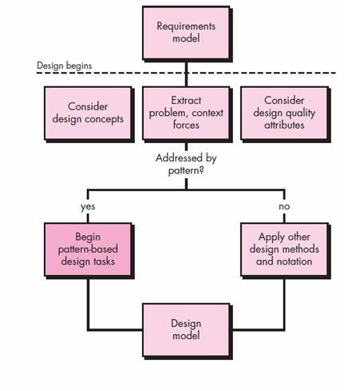
2.4: Pattern Organization Table
What is Pattern Organization Table?
- A structured framework to catalog and manage design patterns effectively.
• Begins with a requirements model (either explicit or implied)
• Presents an abstract representation of the system •
Describes the problem set, establishes the context, and identifies the system of forces.
• Use methods and modeling tools only when you’re faced with a problem, context, and system of forces that have not been solved before.

Slide 4
4: Building a Pattern Organization Table
Steps to Create a Pattern Organization Table:
1. Gather Patterns:
- Collect design patterns from various sources such as design textbooks, websites, and case studies.
2. Organize Patterns by Categories:
- Classify patterns based on their application, context, or user interaction.
3. Document Each Pattern:
- Fill in the components of the table for each pattern systematically.
4. Review and Refine:
- Share the table with stakeholders or peers for feedback, and make improvements as necessary.
5. Update Regularly:
- Continuously add new patterns or revise existing ones based on evolving design trends and insights.

Slide 5
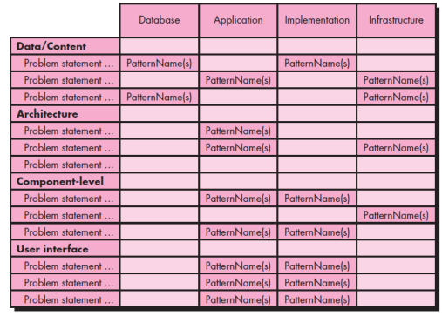
Sample Pattern Organization Table:
Pattern organization table

